Slide 1
Writing Papers in the Biological Sciences
An introduction to Biological research and paper writing

Slide 2
Chapter Five: Writing a Review Paper
What is literature review (LR)?
A literature review discusses published information in a particular subject area, and sometimes information in a particular subject area within a certain time period.
A LR can be just a simple summary of the sources, but it usually has an organizational pattern and combines both summary and synthesis.

Slide 3
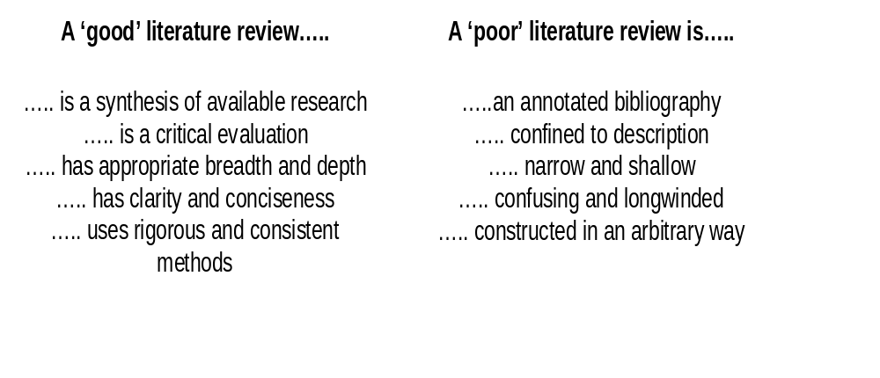
Good and Poor LR

Slide 4
Choosing a Topics
Do not underestimate the importance of choosing a suitable topic.
Ideally, it should be:
interesting to you
not so broad that it is unmanageable
not so narrow that you can’t find enough information on it
not so difficult that you can’t fully understand it.

Slide 5
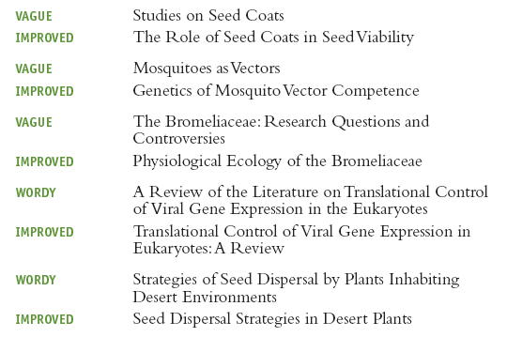
Deciding on a Title
Like a research paper, a review paper should have a specific and informative title.

Slide 6
Working with the Literature
For a biological review paper you need to focus on papers in scientific journals, along with other primary sources.
If you are unsure about how to distinguish primary from secondary sources or about how to locate primary sources seek help from your instructor or your reference librarian.
Remember that the quality of your review paper will depend largely on the sophistication of your literature search, and your mastery of key primary literature.

Slide 7
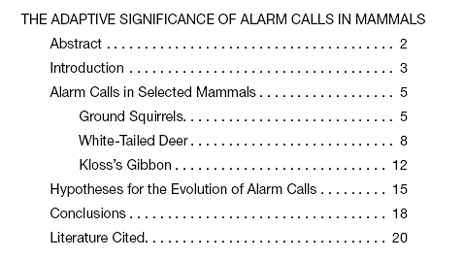
Presenting your Material
Sketch out a rough plan or make an outline.

Slide 8
Include an Abstract, if appropriate.
A published review typically starts with an Abstract stating the purpose and scope of the paper, listing major points about the topic, and summarizing important conclusions.
As in a research paper, the Abstract is placed after the title and author, before the main text of the paper.
Some journals require a Summary at the end of the paper instead of an Abstract at the beginning.

Slide 9
Introduce the subject, explain your rationale, and state your central question, objectives, or thesis.
These three tasks need to be accomplished in the Introduction.
The length of the Introduction depends on your subject and the kind of coverage you plan to give it.
Readers will soon become confused if you do not tell them your objectives fairly early in the paper.
Revision of the Introduction conveys a clearer idea of what this paper is about and why this subject is interesting

Slide 10
Build a focused discussion.
You need to relate this material to your principal objectives.
Present your information selectively, and use it to support or illustrate the statements you wish to make.
A good review interprets the literature from the writer’s own informed perspective and gives the reader a sense of integration, development, and focus.

Slide 11
Document your paper thoroughly.
Whenever you refer to another author’s work or ideas, cite your sources using conventional methods of literature citation (Chapter 6).
Remember that literature citations serve an important function: they tell readers where to find additional information.
Careful documentation also reflects the thoroughness of your literature search and your honesty in acknowledging the sources of your material.

Slide 12
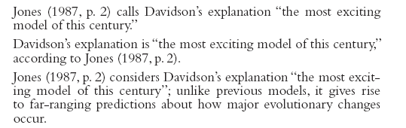
Use quoted material sparingly.
When is it appropriate to use the exact wording of an author?
Occasionally you may wish to include a quotation to establish or emphasize an important point or state a precise definition.
When you do use quoted material, cite the source in the text using either the name-year or number method (see Chapter 6).

Slide 13
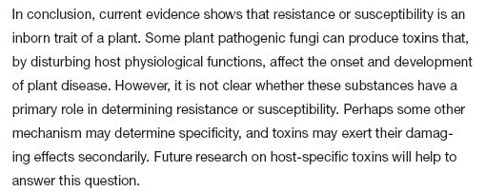
End with general conclusions.
a Conclusions section consolidates and strengthens the relationships, patterns, and arguments you have been building in the body of the paper.
In addition, a good Conclusion should do more than merely summarize; it must also conclude something.

Slide 14
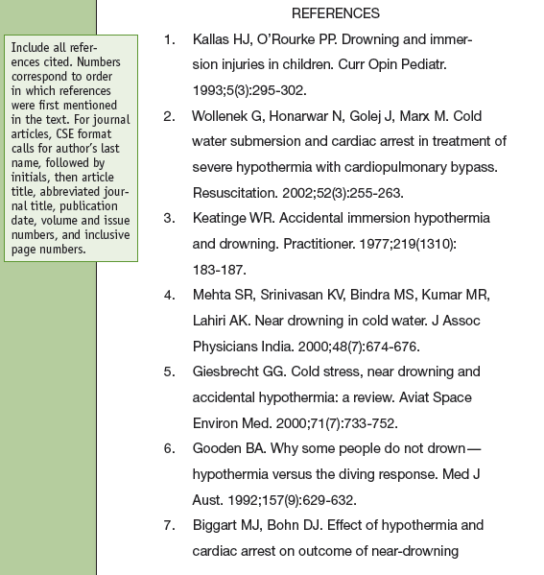
List all cited sources in a References or Literature Cited section.

Slide 15

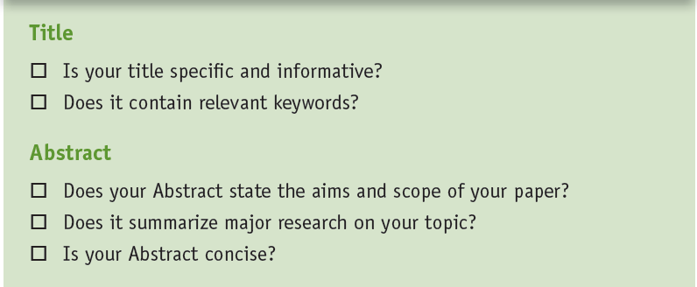

Slide 16
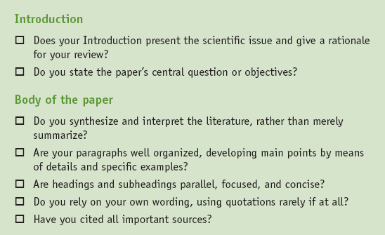

Slide 17
